Slide 1


AUTOMOTIVE TRENDS ANALYSIS REPORT
HARI GANESH SA
NIIT DATA SCIENCE
PYTHON FOR DATA SCIENCE

Slide 2

OBJECTIVE PART - 1
- MARKET SEGMENTATION ANALYSIS
- FUEL EFFICIENCY ANALYSIS
- PERFORMANCE AND WEIGHT ANALYSIS

Slide 3
MARKET SEGMENTATION ANALYSIS
Key Insights
Business Implications
Body Types: SUVs (447 models) dominate, followed by Sedans (333) and Hatchbacks (316), indicating a strong consumer preference for versatile and rugged vehicles. Coupes (41) and MPVs (39) represent niche segments.
Broad Appeal: New launches should prioritize SUV or Sedan body types to capture the largest market segments and ensure broad consumer appeal.
Targeted Fuel Options: Develop Petrol variants for city commuters and Diesel options for consumers who prioritize long-haul efficiency.
Fuel Types: Petrol remains the most prevalent fuel type, especially for urban commuting. Diesel vehicles are preferred for their efficiency, particularly in larger vehicle categories and for highway driving.
Affordability Focus: Consider pricing strategies and feature sets that align with the affordability and value propositions offered by market leaders like Maruti Suzuki and Hyundai.
Top Makes by Models: Maruti Suzuki leads in the number of models offered, reflecting its strong market presence and diverse portfolio. Hyundai and Mahindra also feature prominently, indicating their significant contributions to the market variety.

Slide 4
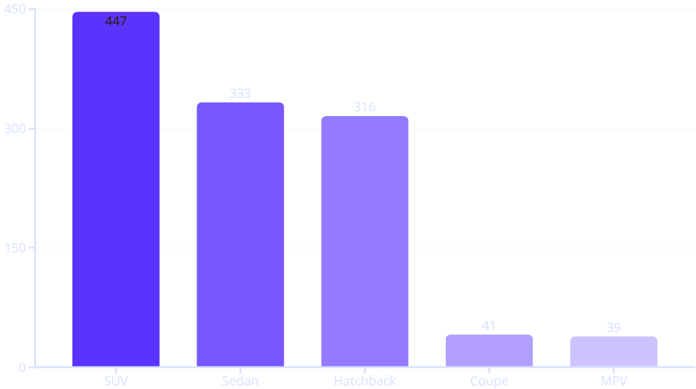
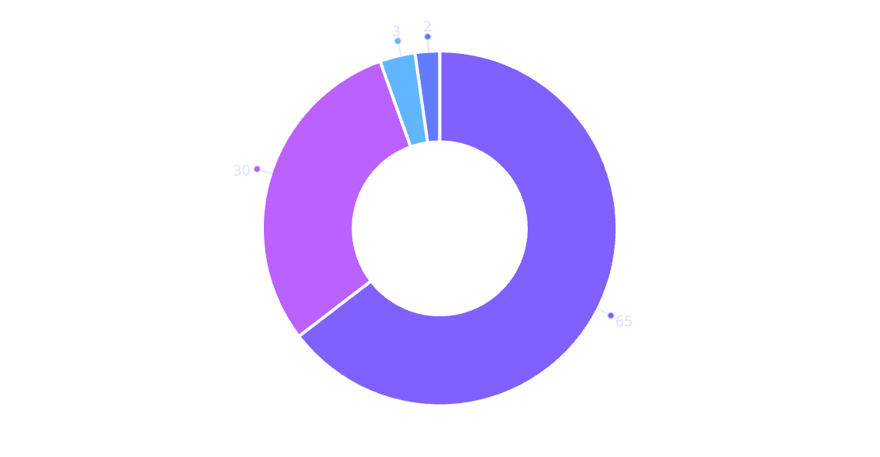
MARKET SEGMENTATION
TOP BODY TYPES IN INDUSTRY
FUEL DISTRIBUTION
Petrol
Diesel
Electric
Hybrid
Top Makes by Model Count
Make
Number of Models
Market Share (%)
Maruti Suzuki
150
25
Hyundai
120
20
Mahindra
90
15
Tata
75
12.5
Honda
60
10

Slide 5
FUEL EFFICIENCY ANALYSIS
Fuel efficiency is a critical factor influencing consumer purchasing decisions, especially with fluctuating fuel prices. This analysis highlights trends in city and highway mileage across different makes and body types.
Key Insights
Business Implications
Average City Mileage by Make: Honda leads with approximately 18 km/l, followed by Toyota and Maruti. This suggests Honda's focus on urban-friendly, fuel-efficient technologies, including hybrids.
Prioritize Efficiency: For new launches, emphasize hybrid or Diesel powertrains to cater to the growing segment of efficiency-conscious buyers.
Targeted Marketing: Market models with high city mileage to urban users who face frequent stop-and-go traffic. For families or those requiring more space, highlight SUVs that offer a balanced approach to efficiency despite their size.
Average Highway Mileage by Body Type: Hatchbacks exhibit the highest highway mileage at around 20 km/l, while SUVs generally show lower efficiency due to their larger size and weight.
Innovation in SUVs: Invest in R&D to improve the fuel efficiency of SUVs, potentially through lighter materials or advanced aerodynamic designs, to make them more competitive in the efficiency segment.
Fuel Type Performance: Diesel cars consistently outperform Petrol vehicles in terms of overall fuel efficiency, making them a preferred choice for long-distance travel.

Slide 6
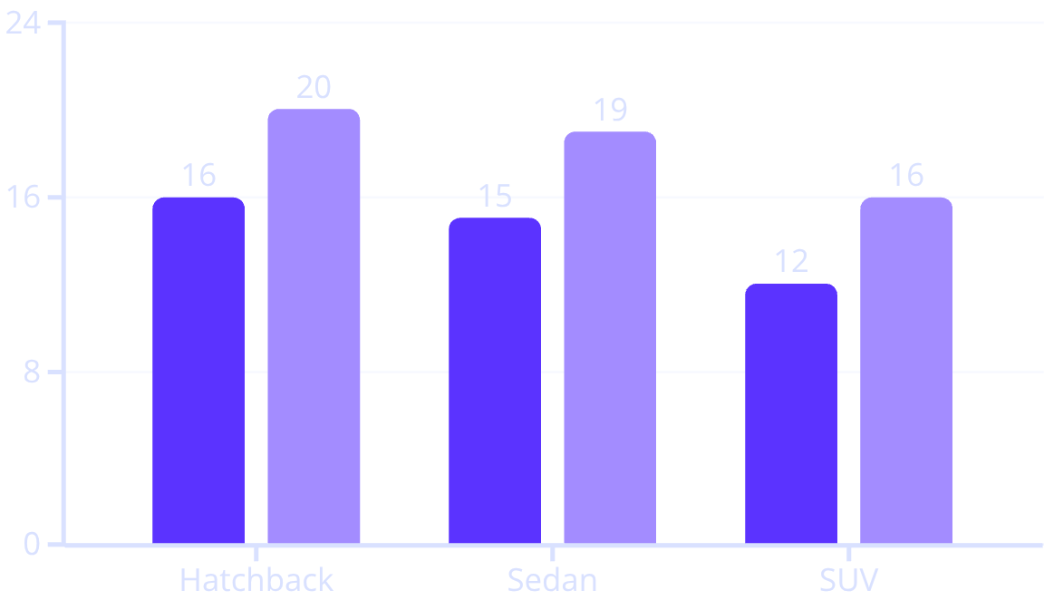
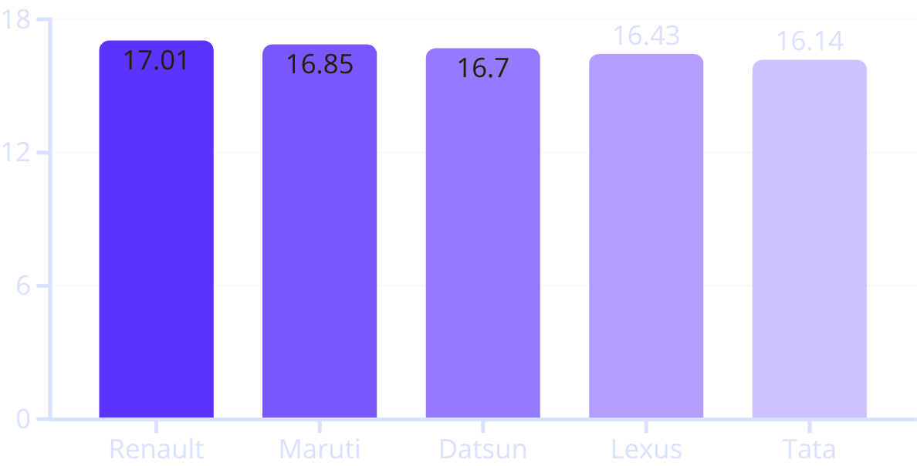
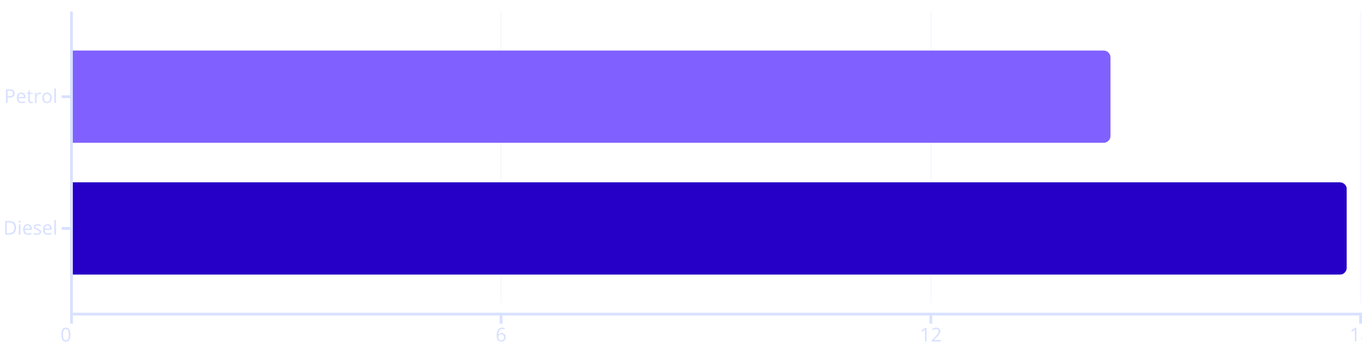
FUEL EFFICIENCY ANALYSIS
TOP MANUFRACTURERS BY AVERAGE MILEAGE
TOP BODY TYPES BY MILEAGES
City Mileage (km/l)
Highway Mileage (km/l)

Slide 7
PERFORMANCE & WEIGHT ANALYSIS
Performance metrics like power and torque, alongside vehicle weight, are crucial for understanding driving dynamics, fuel efficiency, and safety. This section explores how these factors vary across different vehicle segments.
Key Insights
Business Implications
Top Makes by Avg Power: Luxury and sports car manufacturers like Lamborghini (~700 bhp), Ferrari, and Aston Martin lead in average power output, catering to high-performance segments.
Targeted Performance: For mass-market launches, aim for a mid-range power output (150-300 bhp) to balance affordability with adequate performance. High-end performance should be reserved for niche luxury markets.
Top Makes by Avg Torque: Similarly, Lamborghini (~700 Nm) and Bugatti show superior torque figures, essential for rapid acceleration and towing capabilities.
Weight Optimization: Design lighter models, especially for compact segments, to improve fuel efficiency and maneuverability. For SUVs, a heavier build can be marketed as a premium feature enhancing safety and ride comfort.
Kerb Weight Distribution: Average kerb weight ranges from 1200-1500 kg. SUVs tend to be heavier for enhanced stability, while Hatchbacks are lighter for agility and fuel efficiency. Outliers in weight are typically ultra-heavy luxury vehicles.
Strategic Positioning: Clearly define the performance and weight characteristics of new models to align with specific target audiences, whether they prioritize raw power, efficiency, or a blend of both.

Slide 8
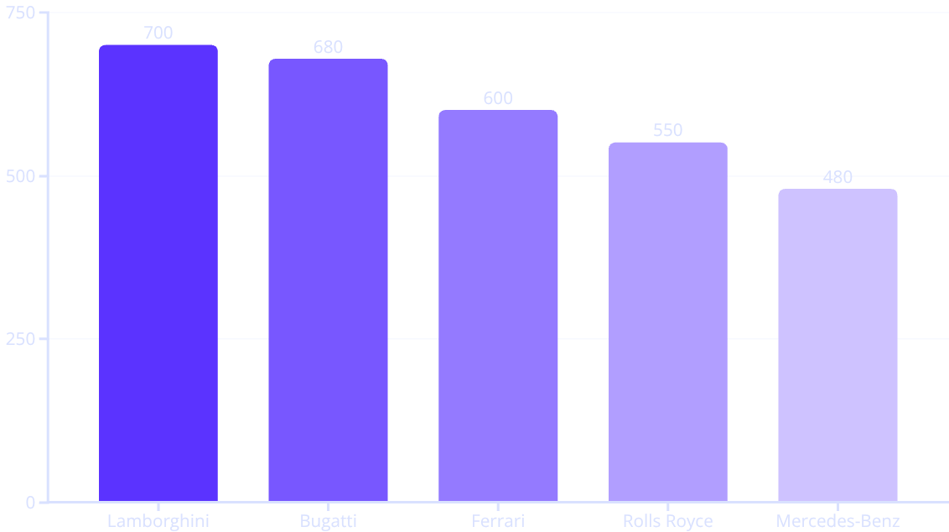
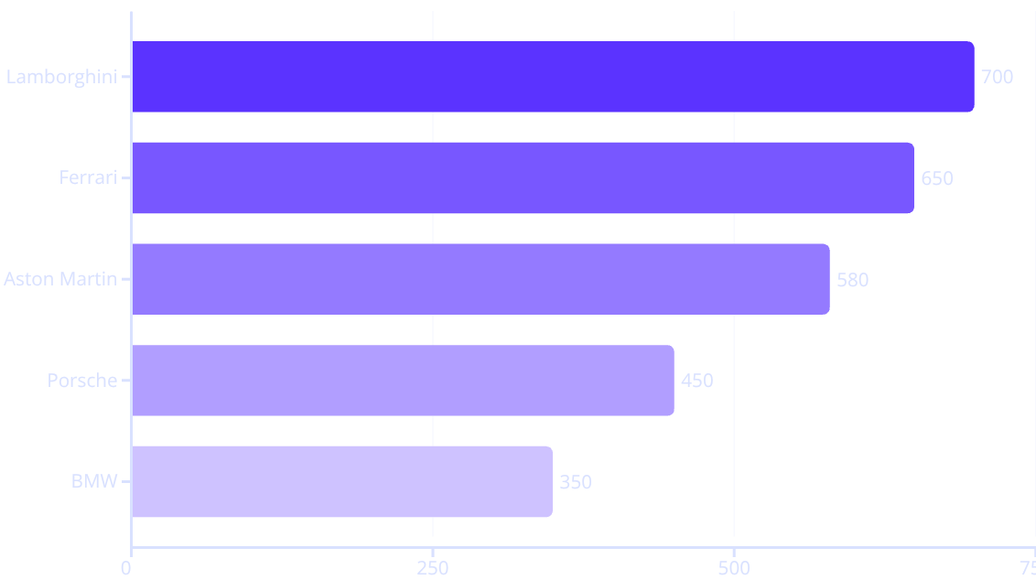
PERFORMANCE & WEIGHT ANALYSIS
TOP PERFORMERS WITH HIGH POWER AND TORQUE
TOP MAKES BY AVERAGE KERB WEIGHT (KG)
Make
Average Weight (kg)
Typical Body Types
Rolls Royce
5700
Luxury Sedan
Bentley
5400
Sedan
Lexus
4800
Sedan, SUV
Bugatti
4400
Sports
Mitsubishi
4300
SUV

Slide 9

OBJECTIVE PART 2
SAFETY FEATURES ANALYSIS
USER COMFORT ANALYSIS
ALERT SYSTEM ANALYSIS
ALERT SYSTEM ANALYSIS

Slide 10
SAFETY AND COMFORT FEATURES
Modern consumers prioritize safety and comfort. This section examines the prevalence of key safety features and comfort-enhancing attributes across various car models, highlighting their impact on market appeal.
Key Insights
Business Implications
ABS Availability: Anti-lock Braking System (ABS) is a near-standard feature, present in over 80% of models, with top makes like Maruti and Hyundai widely incorporating it.
Mandatory Safety: Integrate ABS and a minimum of 4-6 airbags as standard in all new models to meet regulatory requirements and consumer expectations.
Airbag Count: The average number of airbags is 4-6, but luxury brands such as BMW and Mercedes-Benz offer the highest counts, differentiating their premium safety offerings.
Feature Differentiation: For premium segments, offer advanced safety features like higher airbag counts and hill assist to justify higher price points and enhance brand image.
Hill Assist: This feature is particularly common in SUVs from manufacturers like Mahindra and Tata, catering to drivers in varied terrains.
Family-Friendly Design: Focus on 5 - 7seater configurations with robust central locking and child safety features for family-oriented launches. Explore high-capacity vehicles for commercial partnerships.
Seating Capacity: The average seating capacity is 5, The Winger (16 seats) and TUV300 Plus (9 seats) serving commercial or large family segments.
Alert Systems: Incorporate modern alert systems (high-speed, seat belt, door ajar) as standard to provide a competitive edge and appeal to safety-conscious, tech-savvy buyers.
Locking Features: Central locking and child safety locks are prevalent in models from Maruti Suzuki and Hyundai, appealing to family-oriented buyers.

Slide 11



COMPETITOR ANALYSIS
Understanding the competitive landscape is crucial for positioning our new car launches effectively. We've identified key areas of focus among top market players.
EV Dominance
Autonomous Tech
Mass Market Focus
Leading competitors are rapidly scaling EV production, focusing on enhanced range, charging infrastructure, and seamless software integration to capture the premium segment.
Several players prioritize advanced driver-assistance systems (ADAS) and full autonomous driving capabilities through extensive R&D and strategic partnerships.
A segment of competitors targets the mass market with cost-effective models, emphasizing fuel efficiency (hybrid/ICE) and essential smart features for broader appeal.

Slide 12
KEY FINDINGS SUMMARY
This analysis provides a comprehensive overview of current automotive trends and consumer preferences, synthesizing insights from market segmentation, fuel efficiency, performance, weight, safety, and comfort.
Market Dominance
Efficiency & Performance
SUVs and Sedans continue to dominate the market, with Petrol being the primary fuel type, though Diesel remains strong for efficiency.
Fuel-efficient models (especially Diesel and hybrids) are highly valued. Performance varies significantly, with luxury brands leading in power and torque, while mass-market vehicles balance power with affordability.
Safety & Comfort
Alert Systems & Dimensions
ABS and airbags are standard, with higher counts in premium vehicles. Average seating capacity is 5, and features like central locking and child safety are key for family segments.
Modern alert systems are a growing differentiator. Vehicle dimensions vary, with luxury models offering greater volume for spaciousness, while compact models cater to urban needs.
The data consistently reveals a strong consumer preference for vehicles that offer a balanced combination of efficiency, safety, and comfort. Models like those from Kia, BMW, Mercedes-Benz, Land Rover, and Audi exemplify these desired attributes, serving as benchmarks for future launches.

Slide 13



BUSINESS CONCLUSIONS & RECOMMENDATIONS
Based on the comprehensive analysis of automotive trends, we present key conclusions and actionable recommendations for new car launches.
Overall Market Trends
Strategic Recommendations
The market strongly favors SUVs and Sedans with a preference for both Petrol and Diesel fuel types.
High fuel efficiency (above 15 km/l) is a significant driver for consumer choice.
Hybrid SUV Focus
Launch a new Hybrid SUV model with full safety features and advanced alert systems.
Mid-range power (150-300 bhp) strikes a balance between performance and affordability.
Safety features like ABS and multiple airbags are non-negotiable.
Target Efficiency
Comfort features, including 5-seater capacity and central locking, are essential for family segments.
Aim for a city mileage of approximately 18 km/l to appeal to eco-conscious urban families.
Modern alert systems and spacious dimensions contribute to overall appeal.
Family-Centric Design
Ensure 5-7 seating capacity with robust comfort and safety features for family segments.
By focusing on these key areas, new car launches can effectively meet market demands and achieve significant success.

